Slide 1
Data Structure
CSE207
Md. Manowarul Islam
Guest Lecturer
Dept. of CSE, SEU

Slide 2
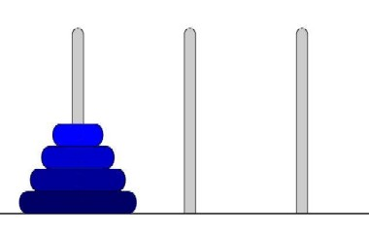
Tower of Hanoi
Tower of Hanoi is a mathematical puzzle invented by a French Mathematician Edouard Lucas in 1883.
The game starts by having few discs stacked in increasing order of size. The number of discs can vary, but there are only three pegs.

Slide 3
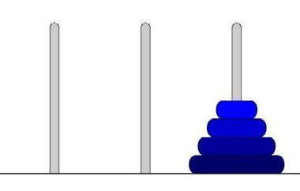
Tower of Hanoi
Legend has it that there were three diamond needles set into the floor of the temple of Brahma in Hanoi.
Stacked upon the leftmost needle were 64 golden disks, each a different size, stacked in concentric order
The priests were to transfer the disks from the first needle to the third needle, using the second as necessary
But they could only move one disk at a time, and could never put a larger disk on top of a smaller one.

Slide 4

Tower of Hanoi
When they completed this task,
the world would end!!!!!

Slide 5
Example
For simplicity, suppose there were just 3 disks, and we’ll refer to the three needles as A, B, and C
Since we can only move one disk at a time, we move the top disk from A to C.

Slide 6
Example
Count# 1
Since we can only move one disk at a time, we move the top disk from A to C.

Slide 7
Example
Count# 2
we move the top disk from A to B.

Slide 8
Example
Count# 3
we move the top disk from C to B.

Slide 9
Example
Count# 4
we move the top disk from A to C.

Slide 10
Example
Count# 5
we move the top disk from B to A.

Slide 11
Example
Count# 6
we move the top disk from B to C.

Slide 12
Example
Count# 7
we move the top disk from A to C.
We have done !!!

Slide 13
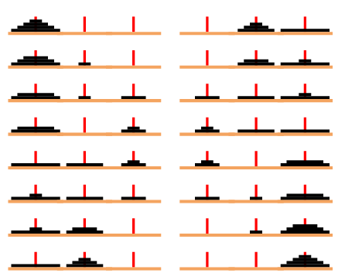
How to solve the 4 disk

Slide 14
Tower of Hanoi
Let q equal to the minimum number of moves necessary to complete the relocation. Examining the case when d = 3 we find n = 7.
d = 4
n = 15
d = 5
n = 31
d = 6
n = 63
d = 7
n = 127
2^{i}-1
d = 8
n = 255
2⁶⁴-1 (a big number)

Slide 15
How big
Suppose that our computer and “super-printer” can generate and print 1,048,576 (2²⁰) instructions/second.
How long will it take to print the priest’s instructions?
There are 2⁶⁴ instructions to print.
  Then it will take 2⁶⁴/2²⁰ = 2⁴⁴ seconds to print them.
1 minute == 60 seconds.
  Let’s take 64 = 2⁶ as an approximation of 60.
  Then it will take ≅ 2⁴⁴ / 2⁶ = 2³⁸ minutes to print them.

Slide 16
How big
Hmm. 2³⁸ minutes is hard to grasp. Let’s keep going...
1 hour == 60 minutes.
  Let’s take 64 = 2⁶ as an approximation of 60.
  Then it will take ≅ 2³⁸ / 2⁶ = 2³² hours to print them.
1 day == 24 hours.
  Let’s take 32 = 2⁵ as an approximation of 24.
  Then it will take ≅ 2³² / 2⁵ = 2²⁷ days to print them.

Slide 17
How big
Hmm. 2²⁷ days is hard to grasp. Let’s keep going...
1 year == 365 days.
  Let’s take 512 = 2⁹ as an approximation of 365.
  Then it will take ≅ 2²⁷ / 2⁹ = 2¹⁸ years to print them.
1 century == 100 years.
  Let’s take 128 = 2⁷ as an approximation of 100.
  Then it will take ≅ 2¹⁸ / 2⁷ = 2¹¹ centuries to print them.

Slide 18
How big
Hmm. 2¹¹ centuries is hard to grasp. Let’s keep going...
1 millenium == 10 centuries.
  Let’s take 16 = 2⁴ as an approximation of 10.
  Then it will take ≅ 2¹¹ / 2⁴ = 2⁷ = 128 millenia just to print the priest’s instructions (assuming our computer doesn’t crash, in which case we have to start all over again).
How fast can the priests actually move the disks?
I’ll leave it to you to calculate the data………………….

Slide 19
How big
Parville’s story the priests had to relocate a tower of 64 disks. Therefore:
Supposing that the priests were proficient enough to make a move a second, the world would end in 584,942,417,355.1 years.

Slide 20
A Solution to the Towers of Hanoi Problem
The following algorithm is to find a recursive solution to the Towers of Hanoi problem.
Algorithm: Tower(N, Beg, Aux, End)
This algorithm gives a recursive solution to the Towers of Hanoi problem for N disks.
1. If N = 0 then Return.
2. If N = 1 then Write: Beg → End and Return.
3. [Move N-1 disks from Beg to Aux.]
Call Towers-of-Hanoi(N-1, Beg, End, Aux)
4. Write: Beg → End.
5. [Move N-1 disks from Aux to End.]
Call Towers-of-Hanoi(N-1, Aux, Beg, End)
09/08/08
Shaily Kabir, Dept. of CSE, DU

Slide 21
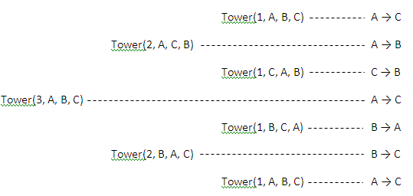
Example: Recursive solution to the Towers of Hanoi problem for N=3.
Figure: Recursive solution to the Towers of Hanoi problem for N=3.
Call Towers-of-Hanoi(N-1, Beg, End, Aux)
Beg → End.
Call Towers-of-Hanoi(N-1, Aux, Beg, End)
Assignment: Write a recursive solution to the Towers of Hanoi for N=5.
09/08/08
Shaily Kabir, Dept. of CSE, DU

Slide 22
End

